Slide 1
N^{th} Order Shift Expansion: Signals
June 23 2020
Nth order shift signals:
Gaussian-Gaussian and Tophat-Gaussian

Slide 2
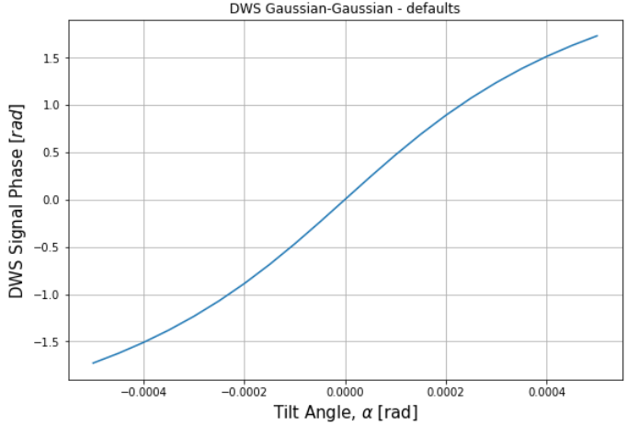
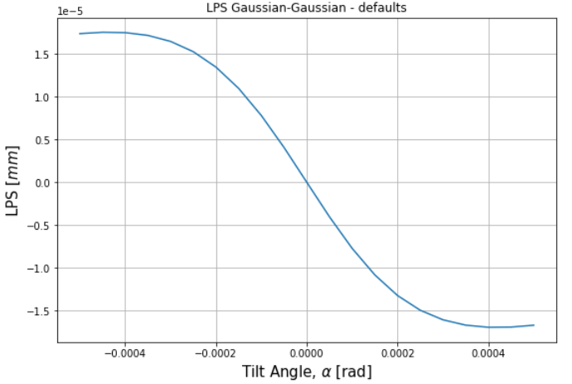
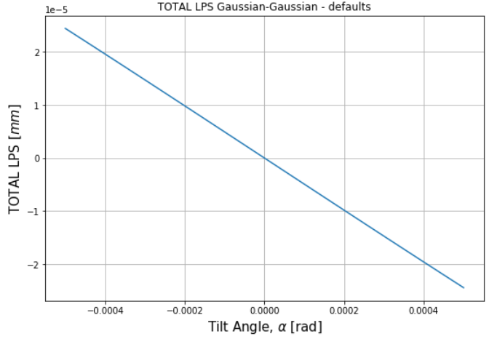
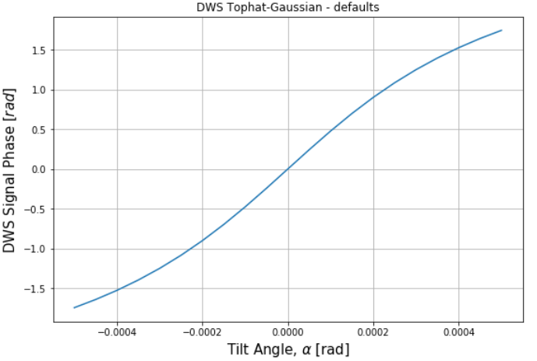
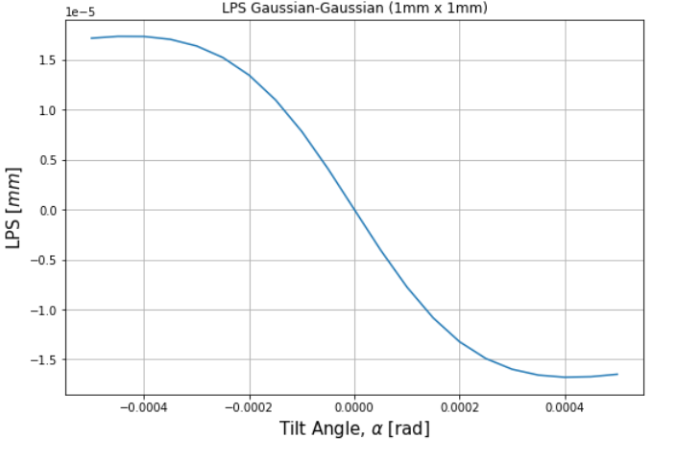
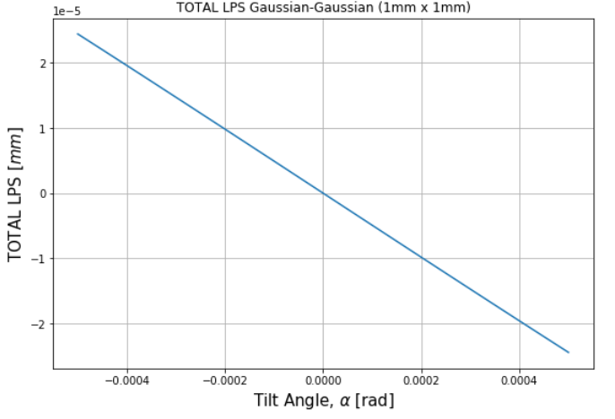
HG00-HG00 (first-order, 100 um) … sanity check
Generalized
(new)
Original
(old)

Slide 3
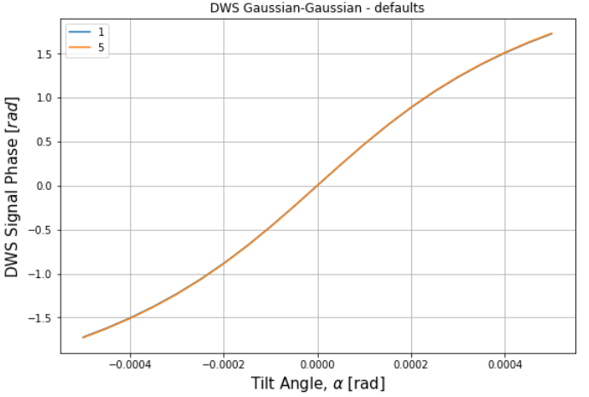
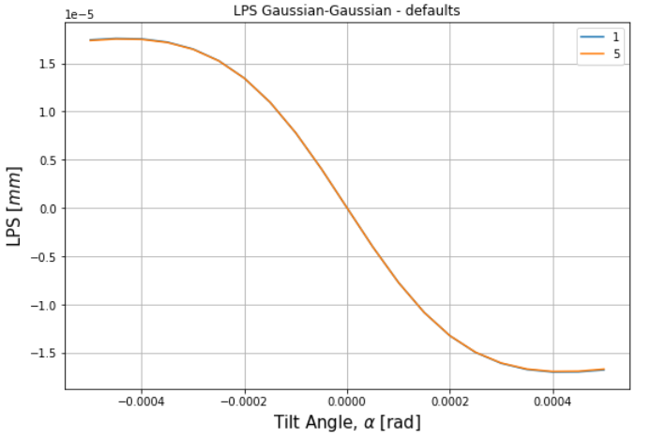
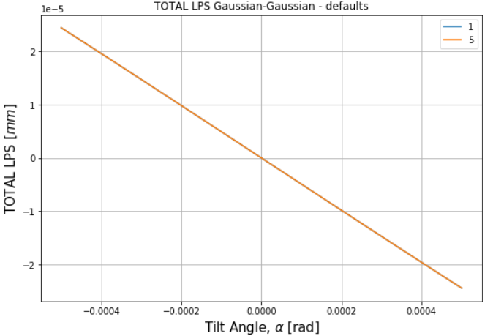
HG00-HG00 (100 um)
Nth order shift signals:
N=1 and N=5
1st order agrees with 5th even at parameter space limits for Gaussians

Slide 4
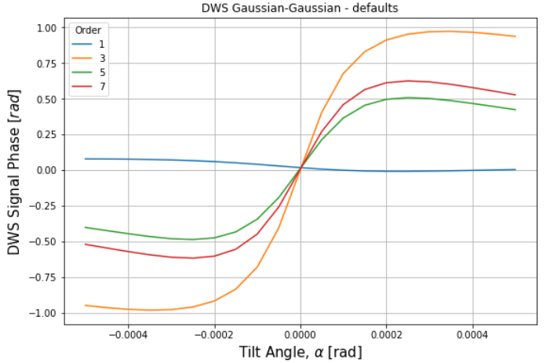
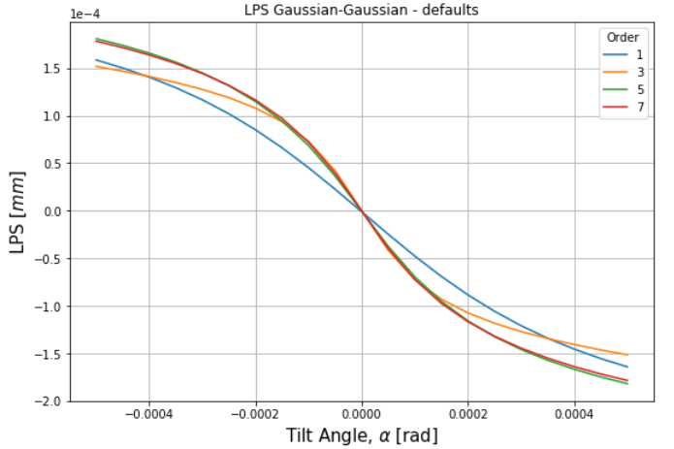
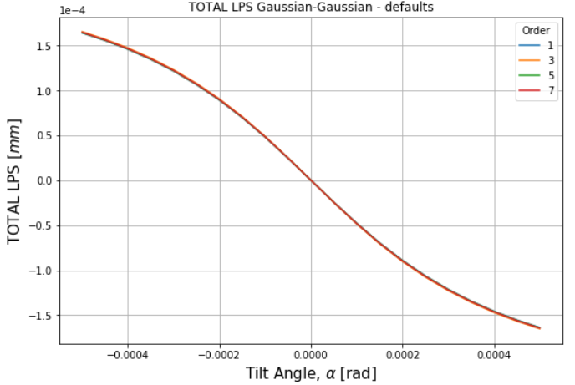
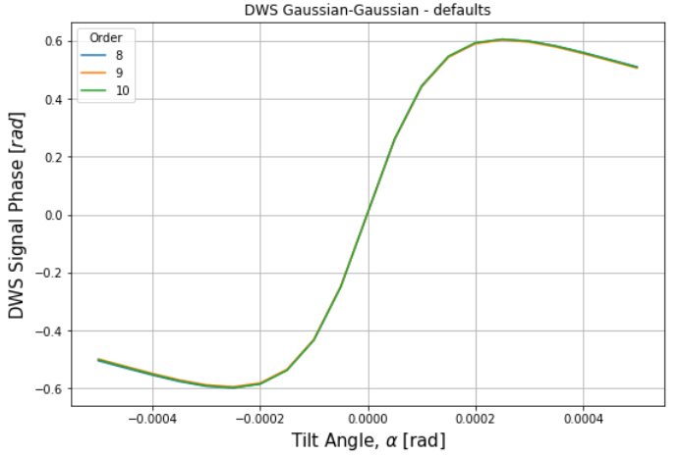
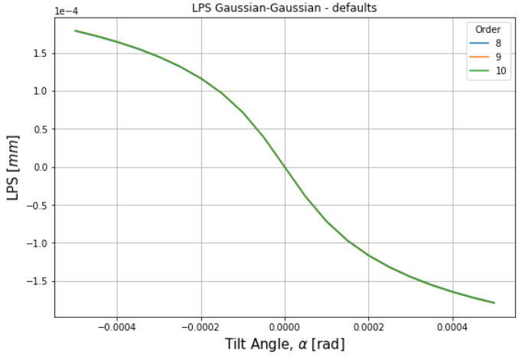
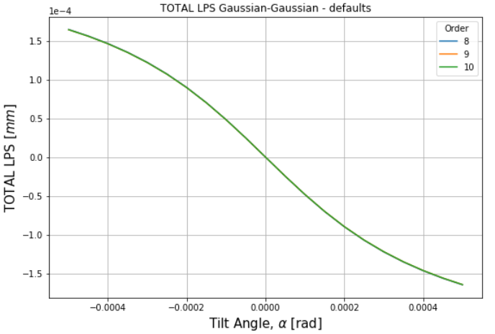
HG00-HG00 (1,000 um)
Nth order shift signals:
N=1,3,5,7
Convergence

Slide 5
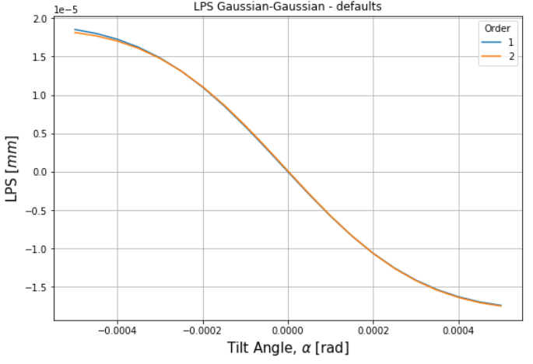
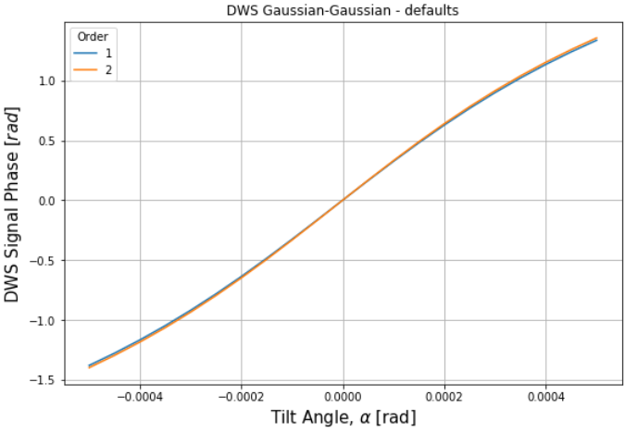
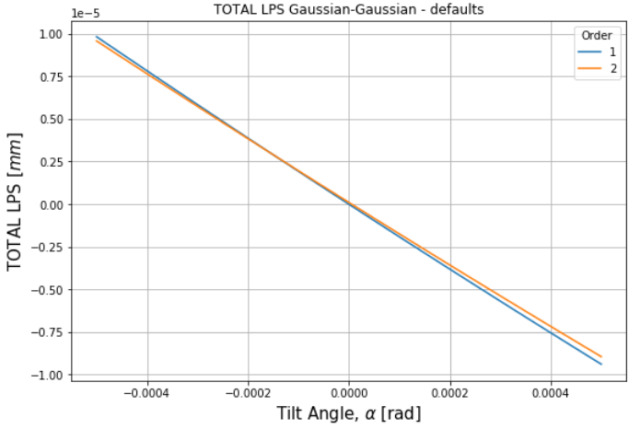
Tophat-HG00 (N=1,2; 100 um)
Minor deviations (c.f. HG00)
Comparison with AW?

Slide 6
